Slide 1

G2M Case Study
Nurlan Ismayil
21-April-2023

Slide 2
Background –G2M(cab industry) case study
XYZ is a private equity firm in US. Due to remarkable growth in the Cab Industry in last few years and multiple key players in the market, it is planning for an investment in Cab industry.
Objective : Provide actionable insights to help XYZ firm in identifying the right company for making investment.
The analysis has been divided into four parts:
Data Understanding
Forecasting profit and number of rides for each cab type
Finding the most profitable Cab company
Recommendations for investment

Slide 3
Data Exploration
24 Features( including 9 derived features)
Timeframe of the data: 2016-01-31 to 2018-12-31
Total data points :355,032
Assumptions:
Outliers exist in the Price_Charged property, but
the absence of trip time details, we do not consider this an outlier.
Trip profit is calculated holding other factors constant, and only the Price_Charged
and Cost_of_Trip properties are used to calculate profit
The users attribute of the city dataset is treated as the number of taxi users in
the city. We assumed it could be other taxi users (including Yellow and Pink cab)
Cab_Data.csv
Customer_ID.csv
Transaction_ID.csv
City.csv
USholiday.csv
Final cab data

Slide 4
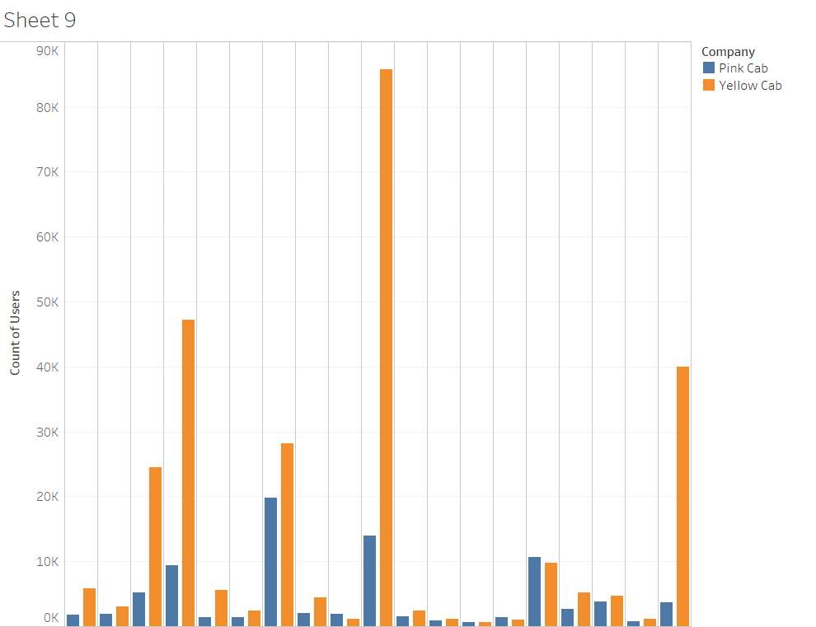
Profit Analysis
Customers rate by Companies in the
context of Cities

Slide 5
Yearly Profit Analysis

Slide 6
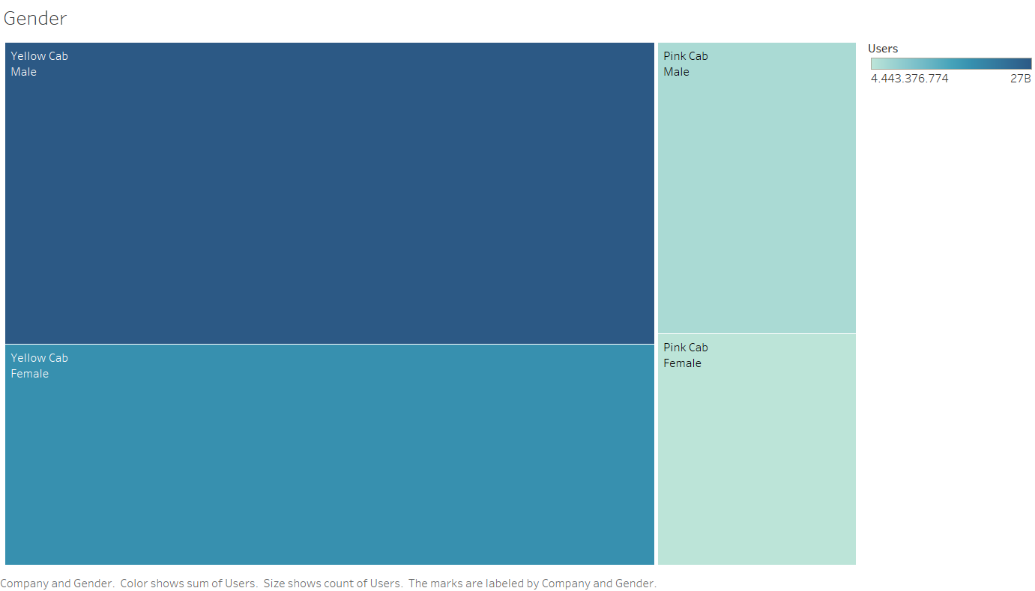
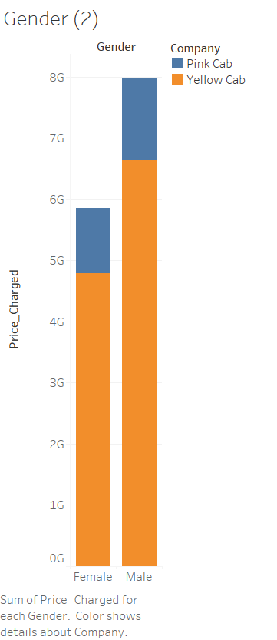
User base Analysis Gender wise

Slide 7
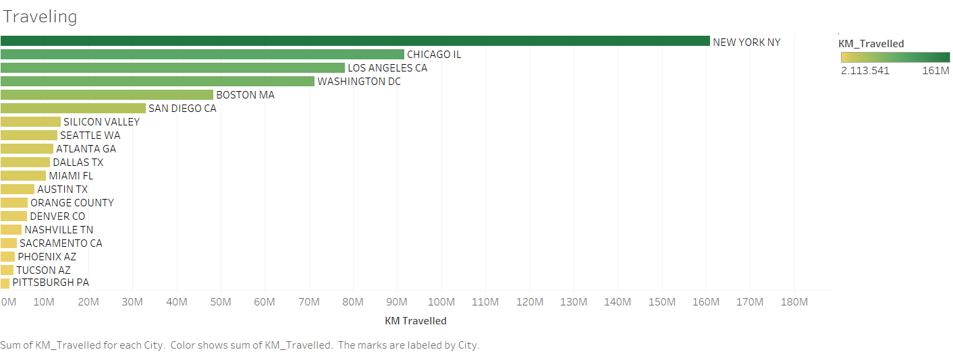
Travelled km in the context of City

Slide 8
City Wise Cab Users Covered By Company
This is the number
of users covered by
Yellow and Pink cab
In the city against
all cab users present
In the city

Slide 9
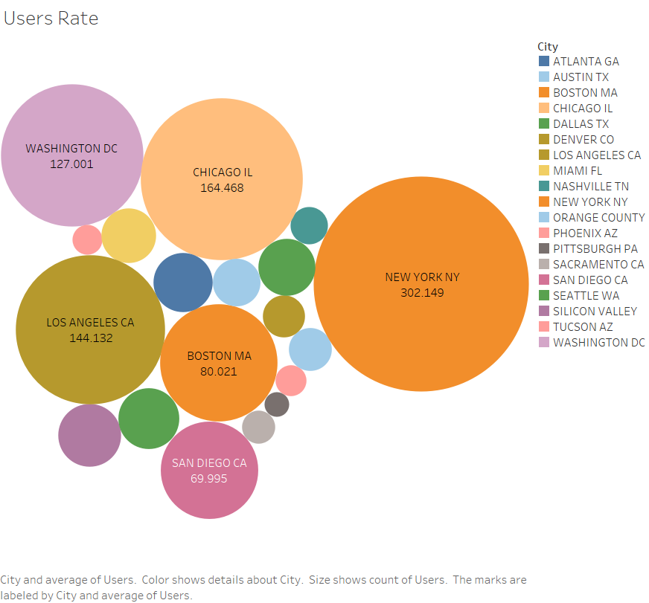
User rate by City
We can see that in this graph top 5 cities New York, Chicago, Washigton and Los Angles have more cab users

Slide 10
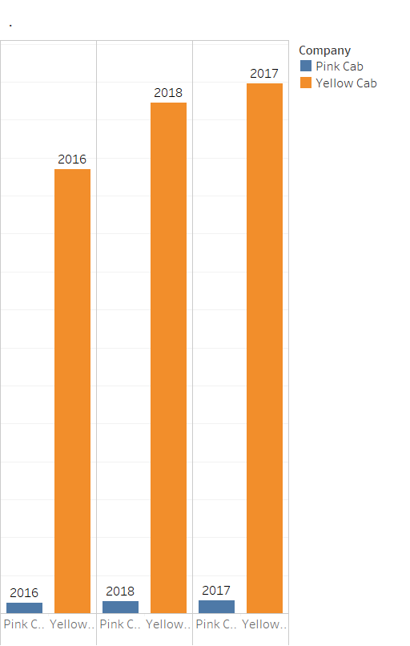
Profit of Companies by Years wise

Slide 11
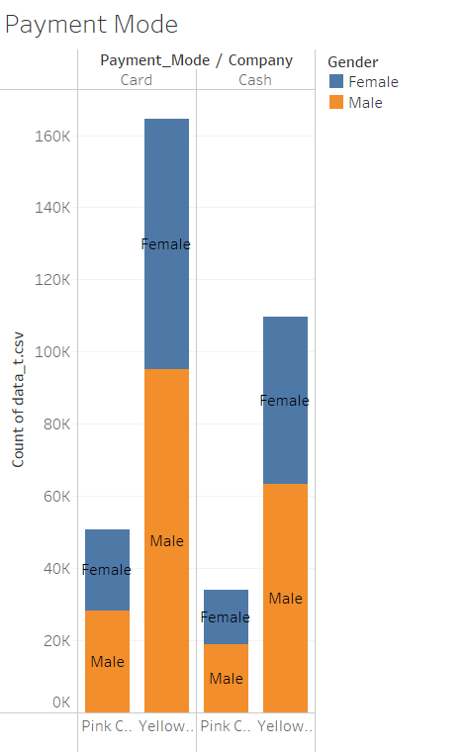
User and Payment Mode Covered by Company
and Customer base Year wise

Slide 12
Recommendations
We have searched both the cab companies on following points and found Yellow cab better than Pink cab:
Customers rate by Companies : Yellow cab has higher customer reach in 24 cities while Pink cab has higher customer reach in 5 cities. We have also observed that Yellow cab is doing good in covering other cab users as compared to Pink cab. Also New York, Chicago and Los Angles have more customers. Because those vities have higher population than other cities.
Travelled KM by : Yellow cab has more users than pink cab and this factor deeply effect to get more profit than pink cab.
Average Profit per KM in Cites: Yellow cab’s average profit per KM is almost three times the average profit per KM of the Pink cab.
Cash and Credi:Both the cabs are very popular to get payvment by cash and nearly 30% customers prefer to pay cash.
On the basis of above point , we will recommend Yellow cab for investment.

Slide 13
Thank You

